Slide 1


Presented by: Fairoz Aly & Kaci Luu
01
02
03
04
Project Description
Software Choice
Features
Demonstration

Slide 2
Table of contents
01
03
04
02
Project Description
Software Choice
Features
Demonstration

Slide 3

01
Project Description

Slide 4


Description
Lightweight Music Player
Efficient, simple, and private
No advertisements or interruptions
Cross-system compatibility

Slide 5



02
Software Choices

Slide 6
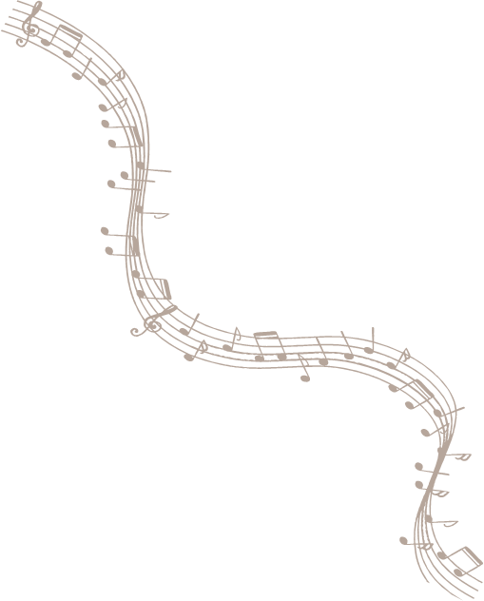
Development Environment & Framework
List of Required NuGet Packages
Programming language: C#
Software framework: .NET Framwork/.NET
UI Framework: Windows Forms
IDE used: Visual Studio 2022

Slide 7


List of Required NuGet Packages
Package Name | Core Purpose | Description
NAudio | Audio Playback | Handle all audio playback, and load and decode music files like MP3s and WAVs.
TagLib# (TagLibSharp) | Metadata Extraction | Read and Parse metadata tags (like Title, Artist, Album, and Duration) directly from music files
Microsoft.Data.SqlClient | The database engine where the music data is stored. | The translator and connector that allows your C# code to send SQL commands (INSERT, SELECT) to the SQL Server and read the results back.
NAudio.SampleProviders | Audio Processing/Volume Boost | Volume track bar logic
System.Configuration | Application Settings | Globalization (I18n)

Slide 8
03
Features

Slide 9
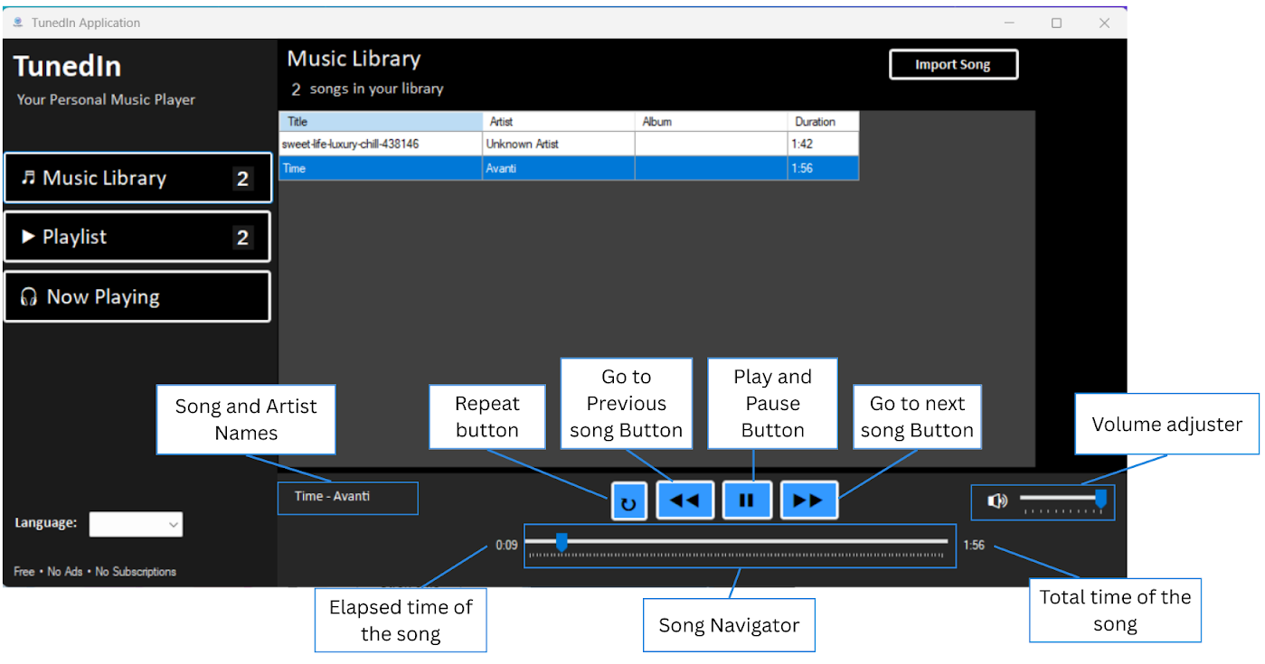

- Play, Pause, Skip, and Repeat Buttons - Volume Adjuster, and Progressive Music Bar

Slide 10
Music Library Panel

Slide 11
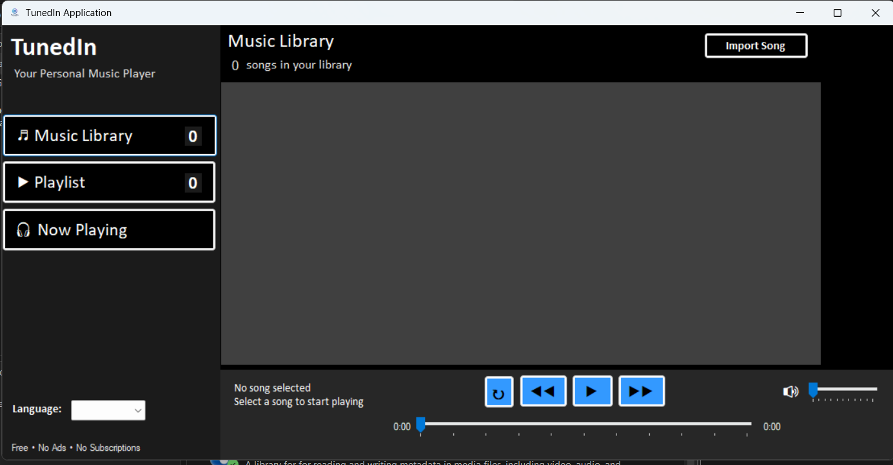
Music Library Panel

Slide 12
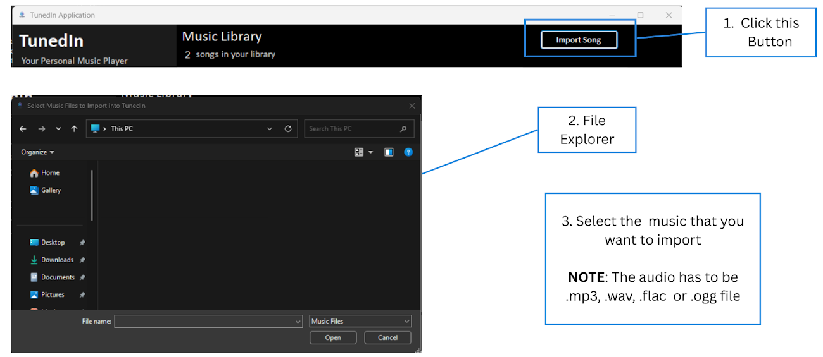
Music Library Panel – Import audio from File Explorer

Slide 13

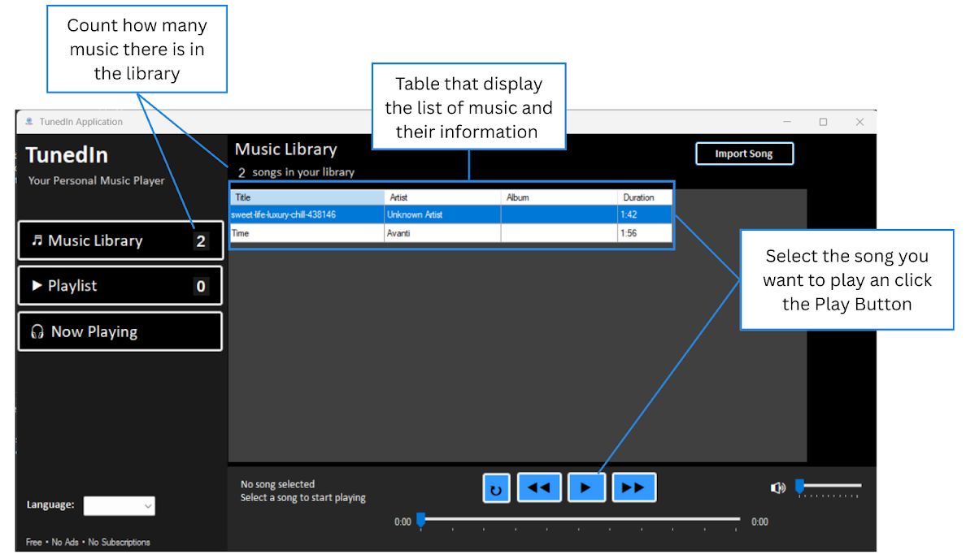
Music Library Panel with Imported audio

Slide 14
Playlist Panel

Slide 15

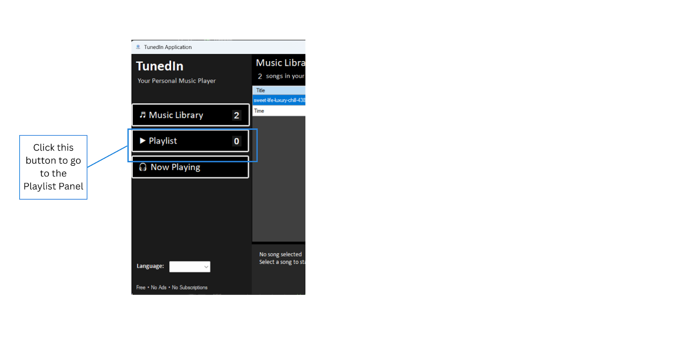
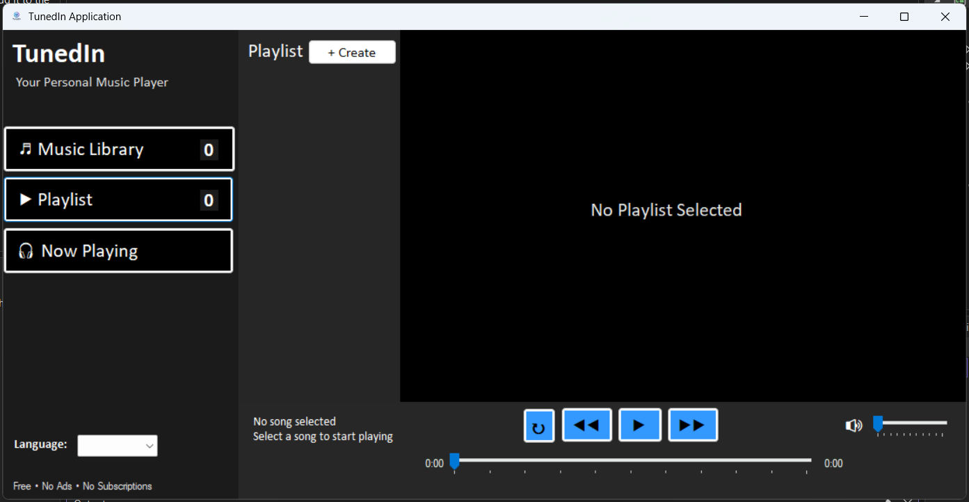
Playlist Panel

Slide 16
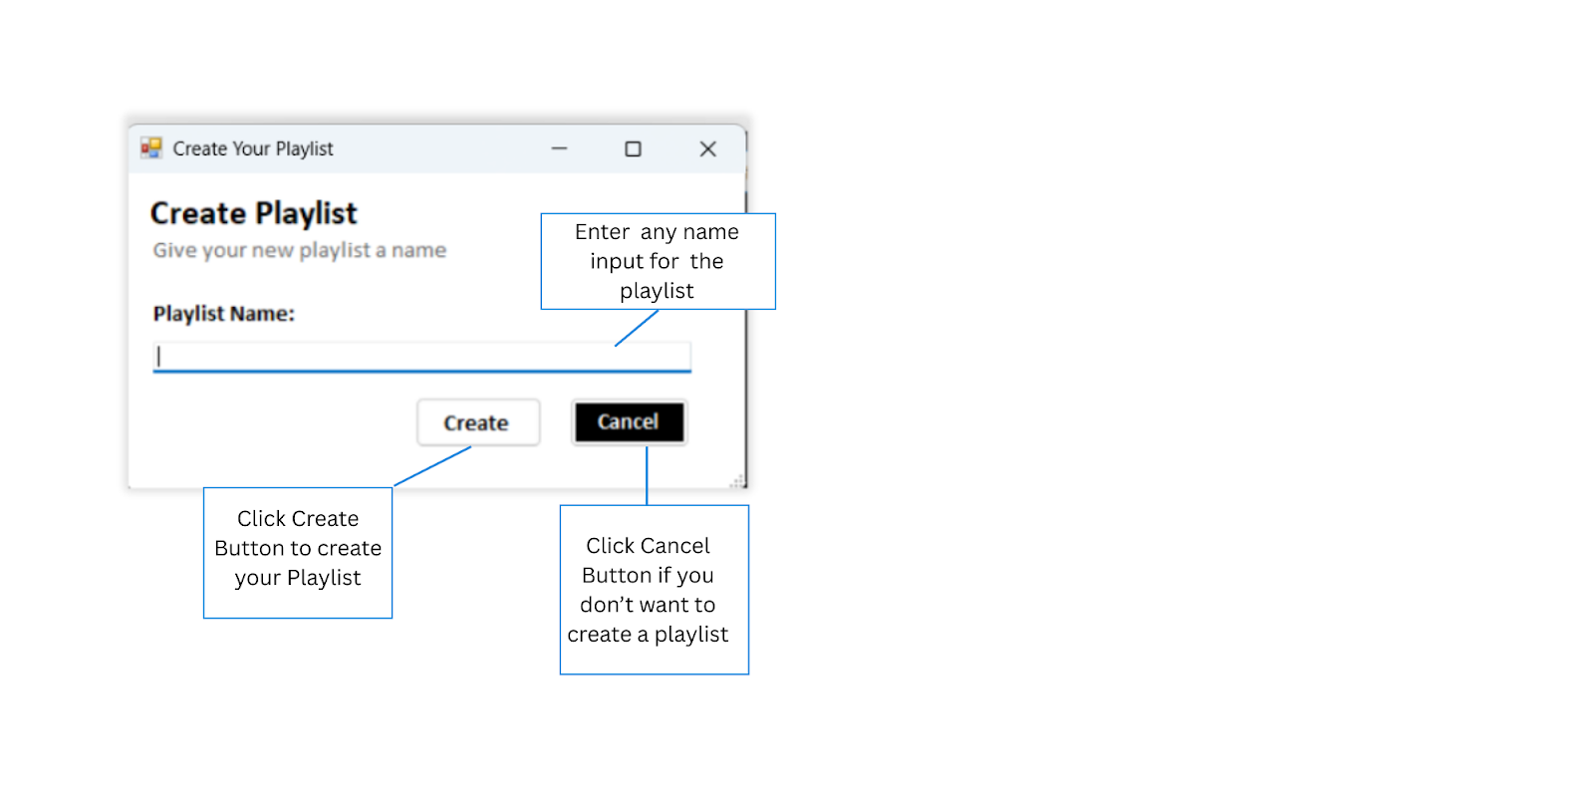
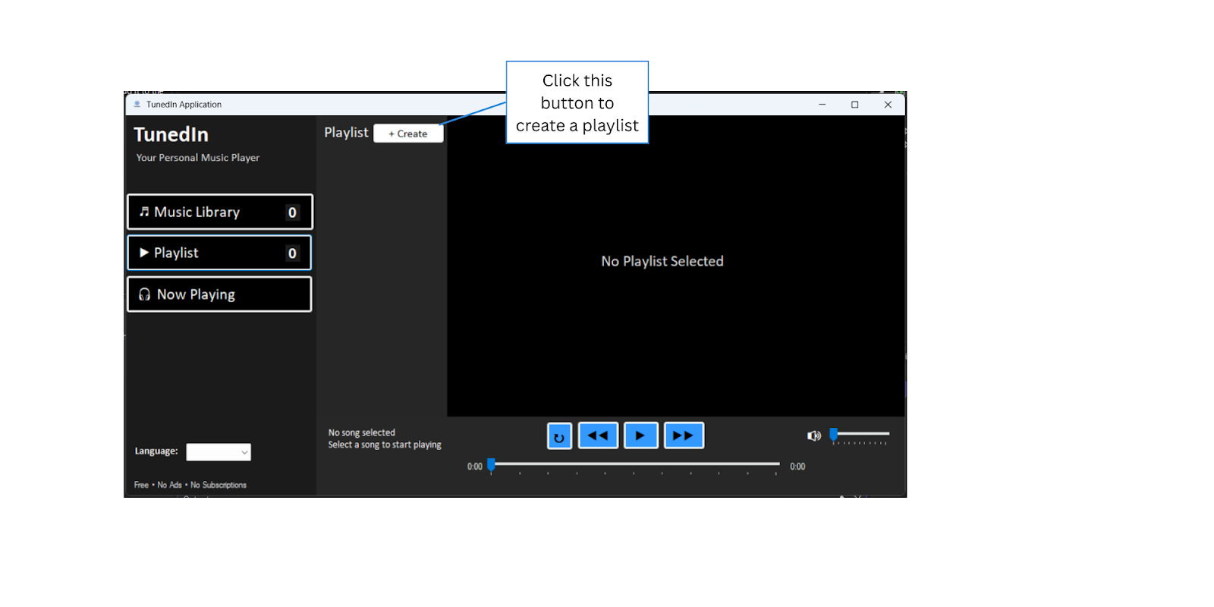
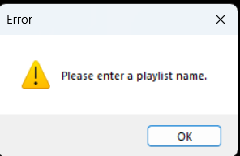
Playlist Panel – Create a Playlist
2.
1.
Exception Handling

Slide 17
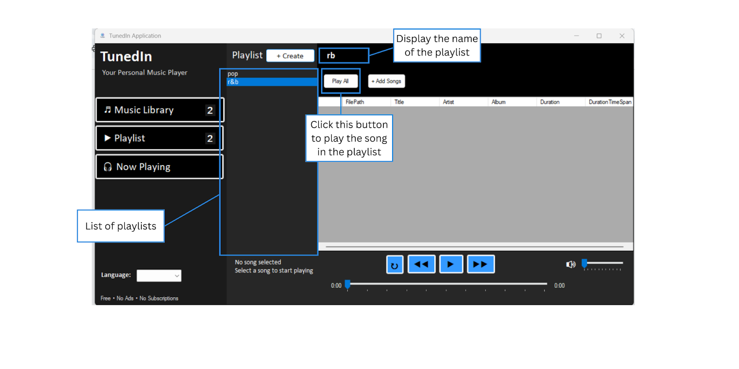

Playlist Panel –After Creating Playlists

Slide 18
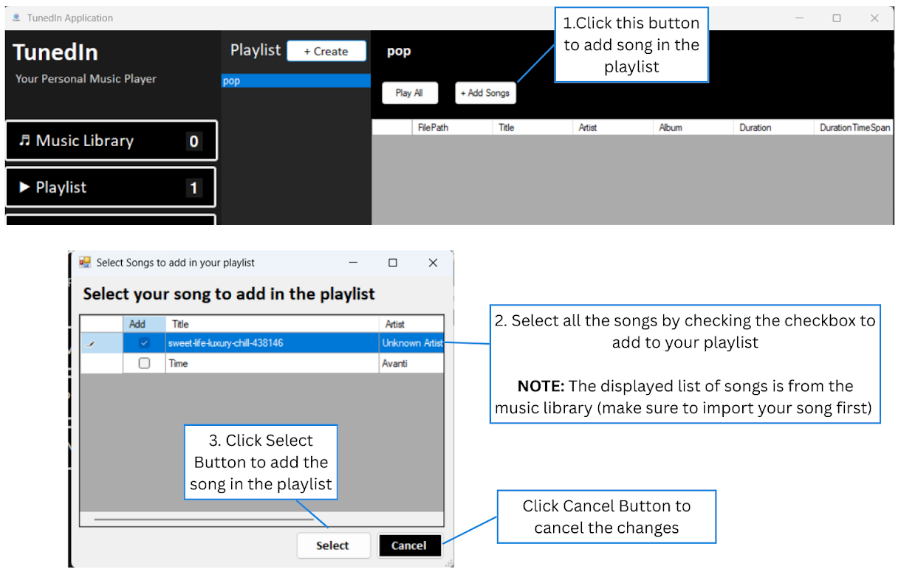
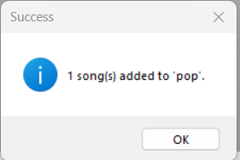
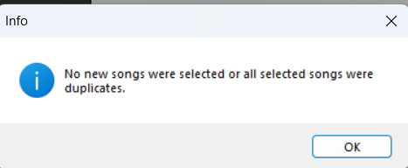
Playlist Panel – Add songs in the Playlist
Exception Handling

Slide 19

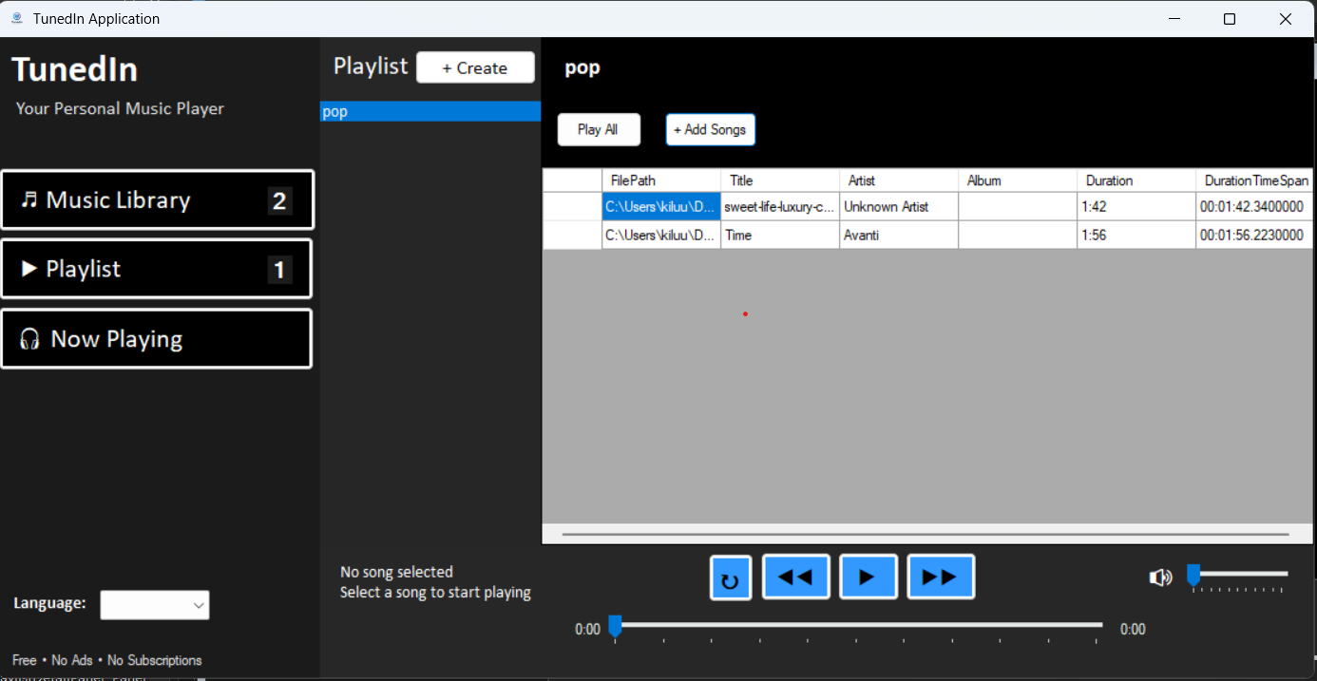
Playlist Panel –After Adding Songs

Slide 20
Now Playing Panel

Slide 21

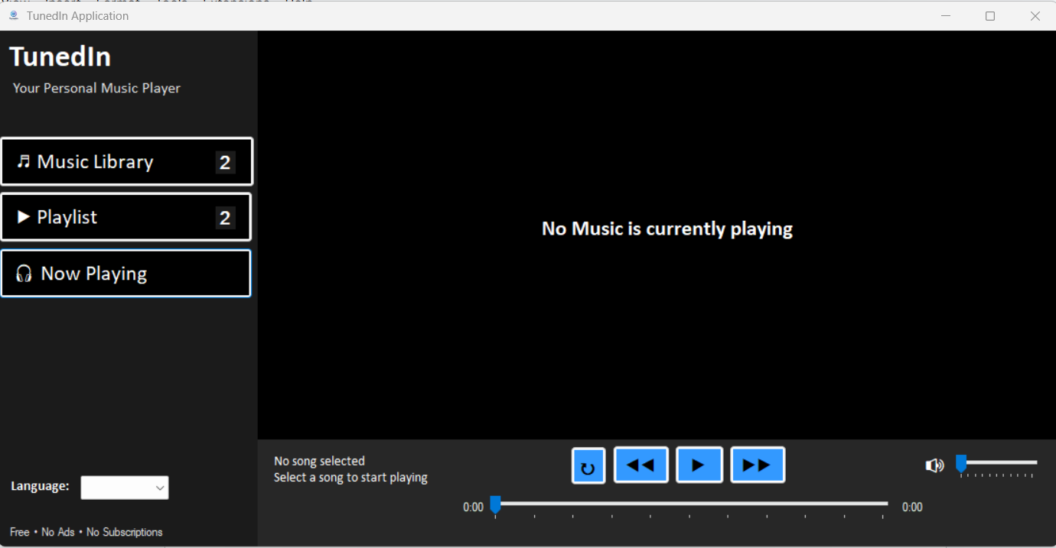
Now Playing Panel -No Song Playing

Slide 22

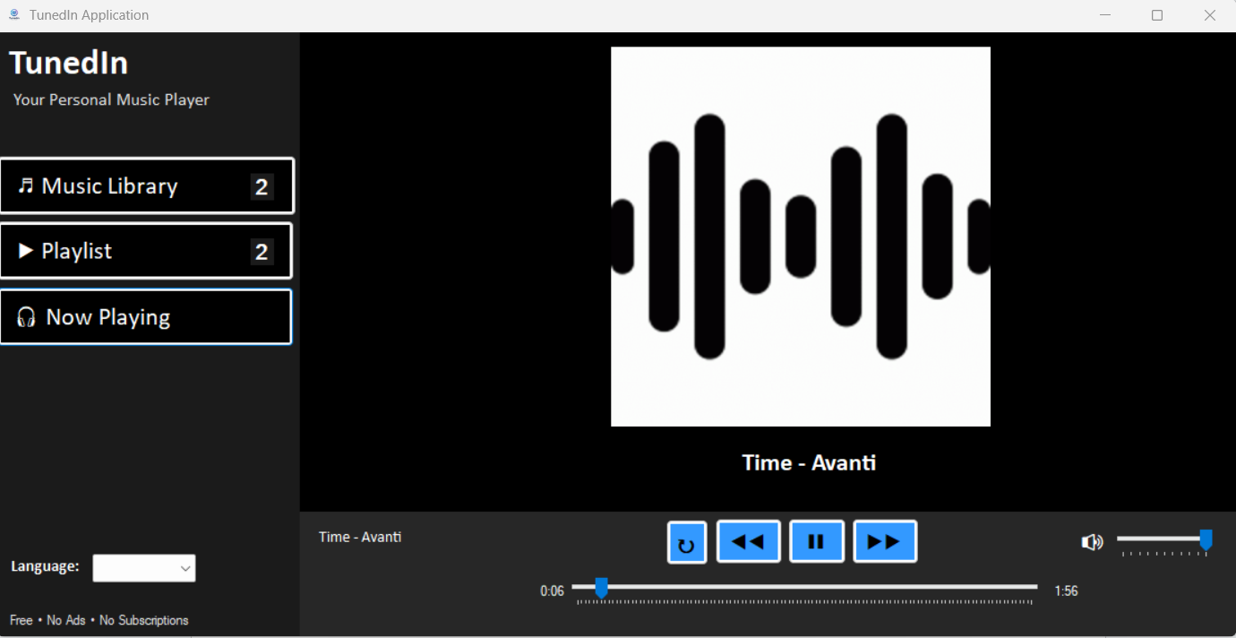
Now Playing Panel –With Song Playing

Slide 23
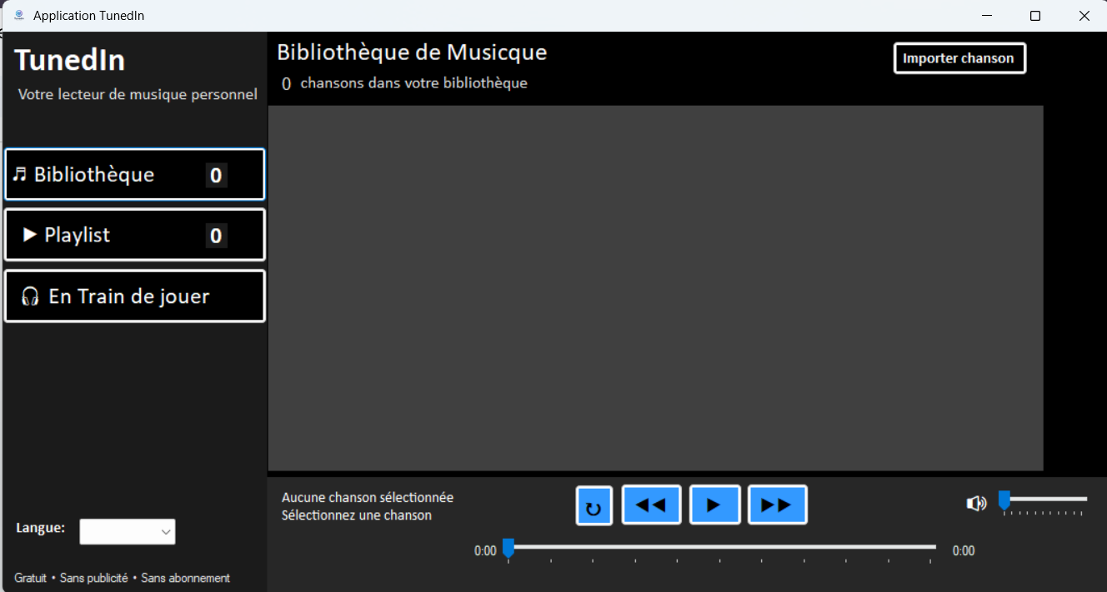
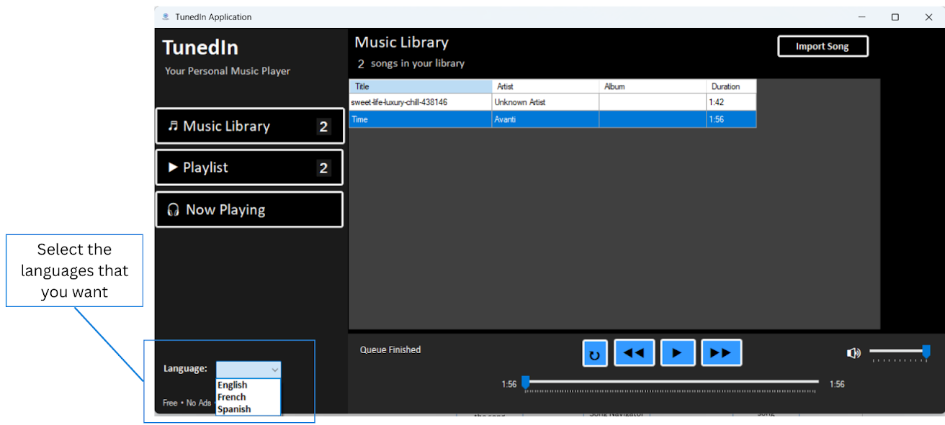
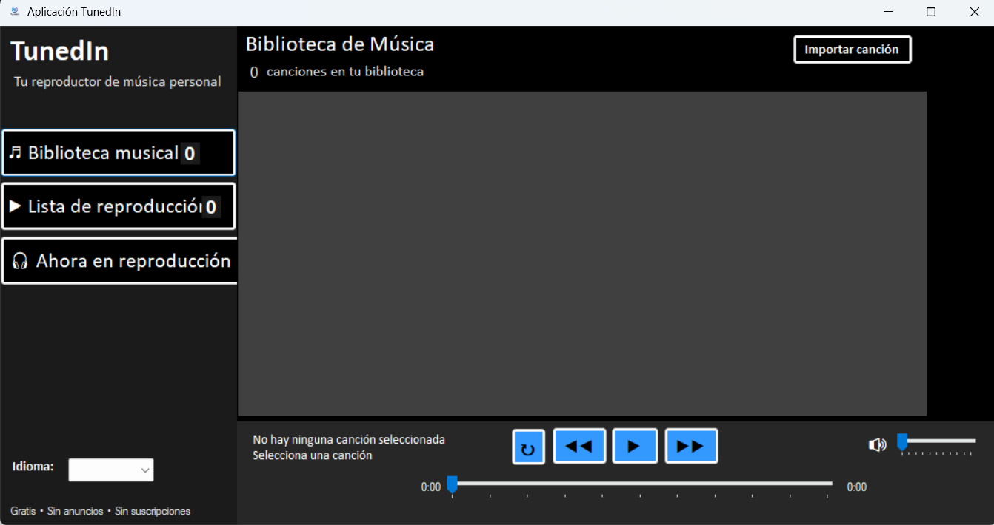
I18N Implementation

Slide 24
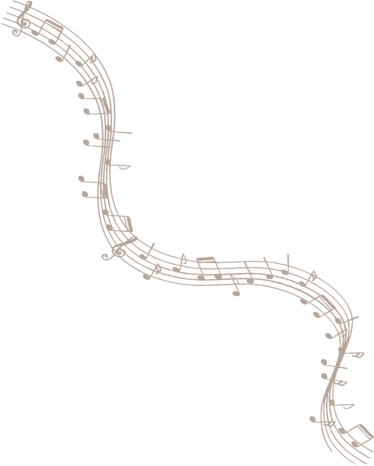
French Version
Spanish Version

Slide 25

04
Demonstration

Slide 26
The End

